Slide 1
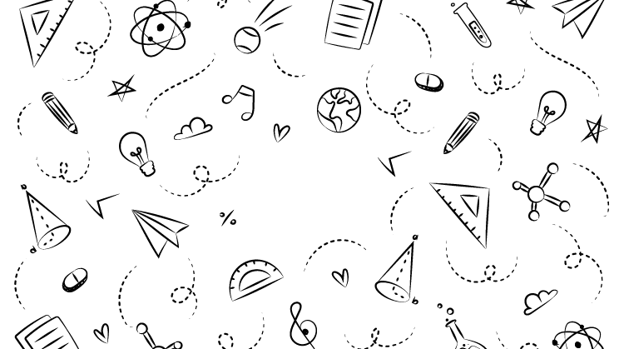



NEXT GEN EMPLOYABILITY PROGRAM
Creating a future-ready workforce
Loyola-ICAM College of engineering and technology
Team Members
Student Name :Ashrutha G
Student ID :au311121205011
Chennai

Slide 2

CAPSTONE PROJECT SHOWCASE
Project Title
Music Web Application using Django Framework
Abstract | Problem Statement | Project Overview | Proposed Solution | Technology Used | Modelling & Results | Conclusion

Slide 3
Abstract:
This project Beatbuddy endeavors to develop a dynamic music web application utilizing the Django framework, aimed at providing users with a comprehensive platform for discovering, organizing, and enjoying music content. With a focus on user-centric design, the application will facilitate seamless user registration and authentication processes, ensuring secure access to personalized features and preferences. Users will have access to an extensive music library, enabling them to explore, search, and delve into a diverse collection of tracks, albums, and artists. Moreover, the application will empower users to curate their own personalized playlists, facilitating organization and easy access to their favorite songs. Leveraging Django's robust capabilities, the application will also offer seamless music streaming directly from the platform, eliminating the need for external software or plugins.
Source :

Slide 4
Problem Statement:
Designing an efficient music application using Django poses challenges such as implementing robust user authentication, managing complex music metadata, enabling seamless audio streaming, and ensuring a responsive frontend interface. The project aims to address these challenges by developing a scalable and user-friendly platform that simplifies music discovery and organization. Key objectives include optimizing database performance for large music catalogs, integrating secure audio streaming capabilities, and delivering a visually appealing and intuitive user experience. The solution will focus on leveraging Django's features effectively to overcome these hurdles and provide a compelling music application that meets modern user expectations.
Source :

Slide 5
Project Overview:
The project entails the development of a robust music web application utilizing the Django framework to provide users with an immersive and personalized music discovery experience. The application will feature functionalities such as user registration and authentication, a comprehensive music library, personalized playlist creation, music streaming, recommendation systems, and social interaction features. Through intuitive user interfaces and responsive design, the platform aims to ensure seamless accessibility across various devices. Leveraging Django's powerful capabilities, the project endeavors to address the fragmented nature of existing music platforms by offering a cohesive solution for discovering, organizing, and interacting with music content. By focusing on enhancing user engagement and satisfaction, the project aims to create a vibrant and dynamic community around music while filling the gaps in the current online music landscape.
Source :

Slide 6
Proposed Solution:
User Authentication and Authorization: Implement secure user registration and login functionality using Django's authentication system. Ensure proper authorization levels for users and administrators to control access to features like song management.
Song Catalog and Management: Develop a robust backend system to manage a catalog of songs, albums, and artists. Utilize Django models to define database schemas for storing music metadata and implement CRUD (Create, Read, Update, Delete) operations for song management.
Admin Dashboard for Song Administration: Create an intuitive admin dashboard accessible only to authorized users (admins). This dashboard allows admins to add new songs, update existing songs (including metadata like title, artist, and genre), and delete songs as needed
User-Facing Home Page with Song Playback: Design a user-friendly home page where authenticated users can browse through available songs and play them directly on the website. Implement audio streaming functionality to deliver a seamless listening experience. Responsive Frontend Design: Develop responsive frontend views using Django templates, HTML, CSS, and JavaScript to ensure a visually appealing and intuitive interface. Focus on usability and responsiveness across different devices and screen sizes to enhance user experience
Source :

Slide 7
Solution:
The proposed solution beatbuddy also includes robust backend infrastructure to support seamless music streaming directly within the application, eliminating the need for external plugins or software. Leveraging Django's powerful ORM and caching mechanisms, the application will ensure efficient data retrieval and delivery, enhancing overall performance and user experience. Furthermore, the integration of cloud storage solutions for music files will enable scalable and reliable content delivery, accommodating a growing user base and expanding music library.
Source :

Slide 8
Moreover, the project will prioritize user feedback and iterative development to continuously enhance and refine the application's features and functionalities. Through user testing and analytics, the team will gather insights to optimize the user experience, improve recommendation accuracy, and address any usability issues. Additionally, regular updates and maintenance will ensure the application remains secure, up-to-date with industry standards, and capable of meeting evolving user needs. By adopting an agile development approach and incorporating user-centric design principles, the proposed solution aims to deliver a cutting-edge music web application that sets new standards for personalized music discovery and engagement.

Slide 9


Technology Used
Front-end
Back-end
Source :

Slide 10
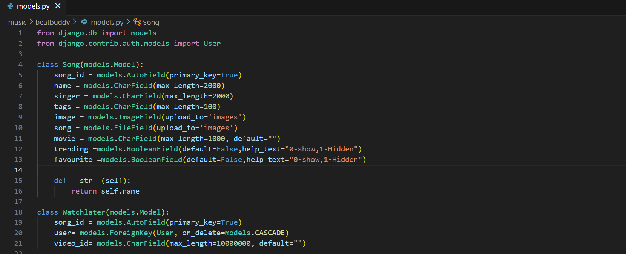
Modelling & Results
Source :

Slide 11
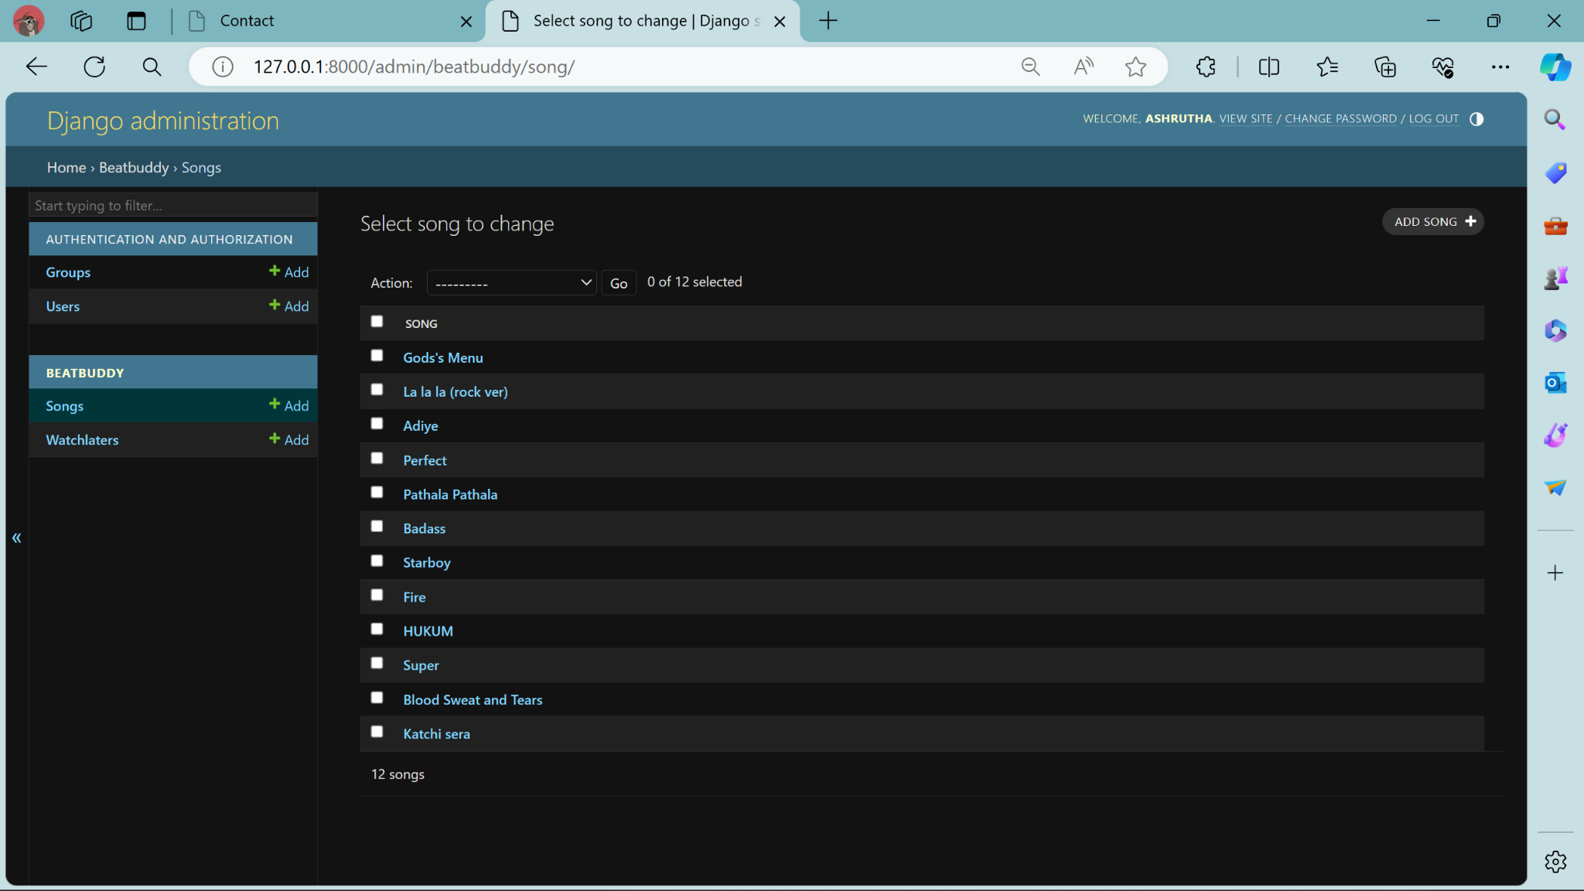
Modelling & Results
Source :

Slide 12
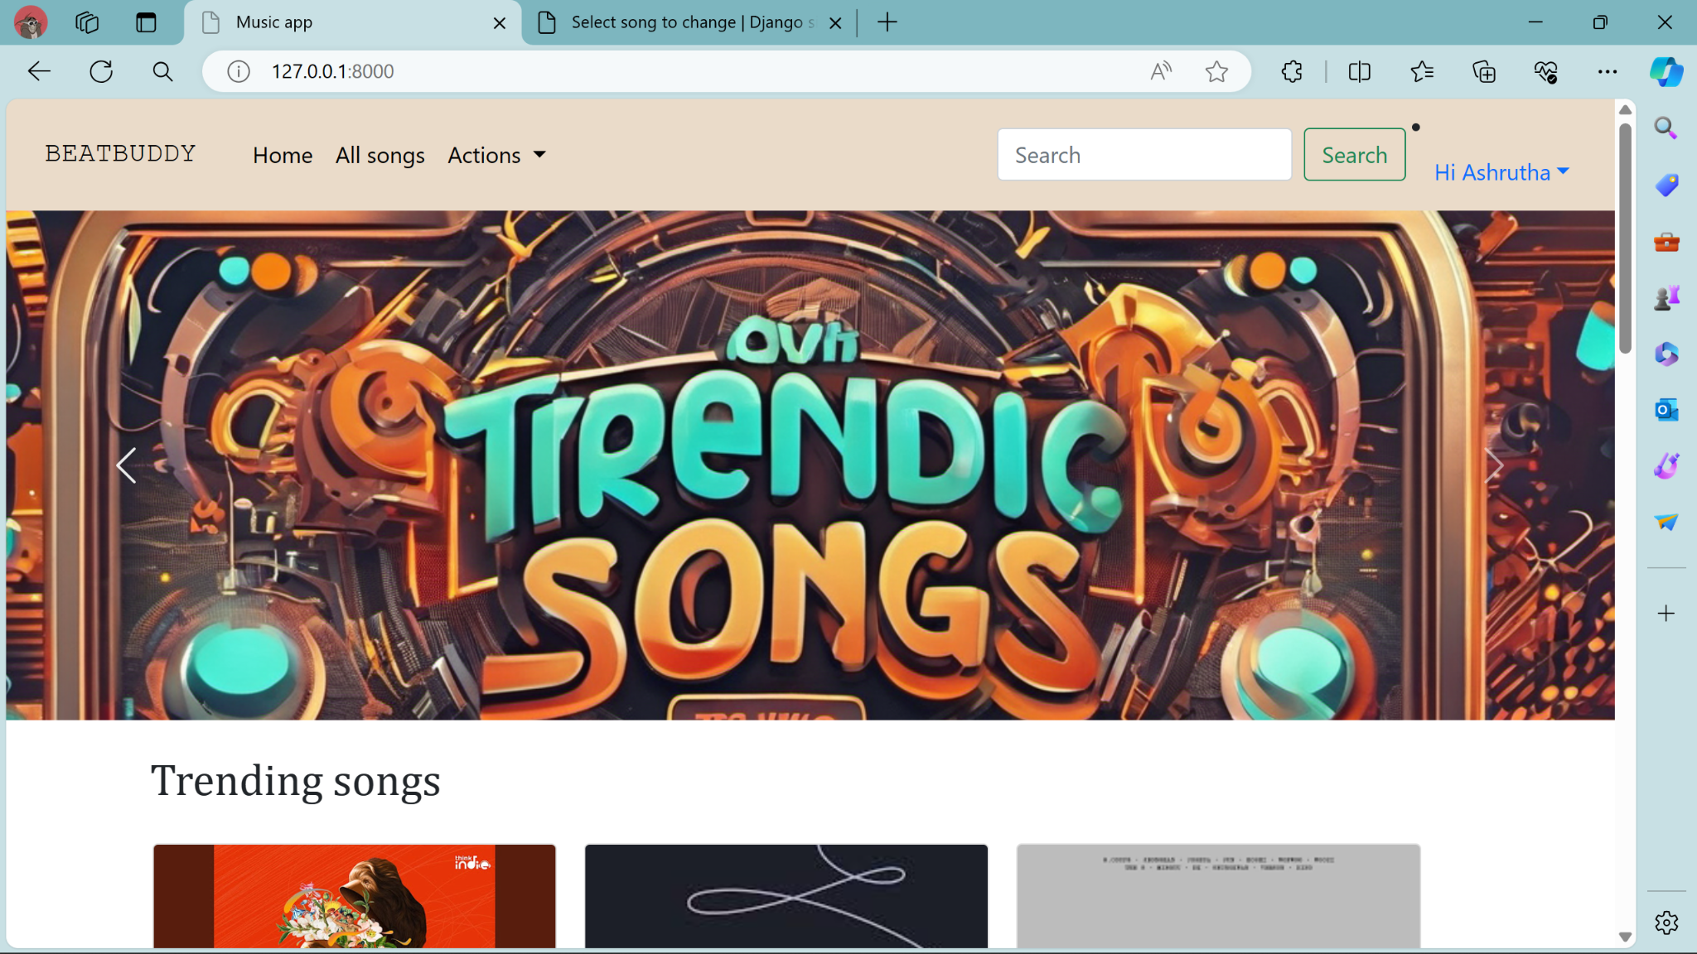
Homepage

Slide 13
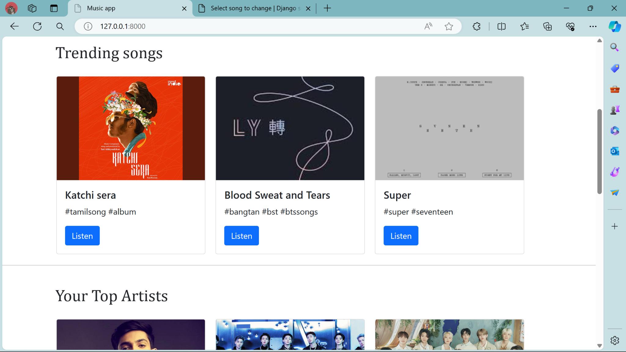
Homepage

Slide 14
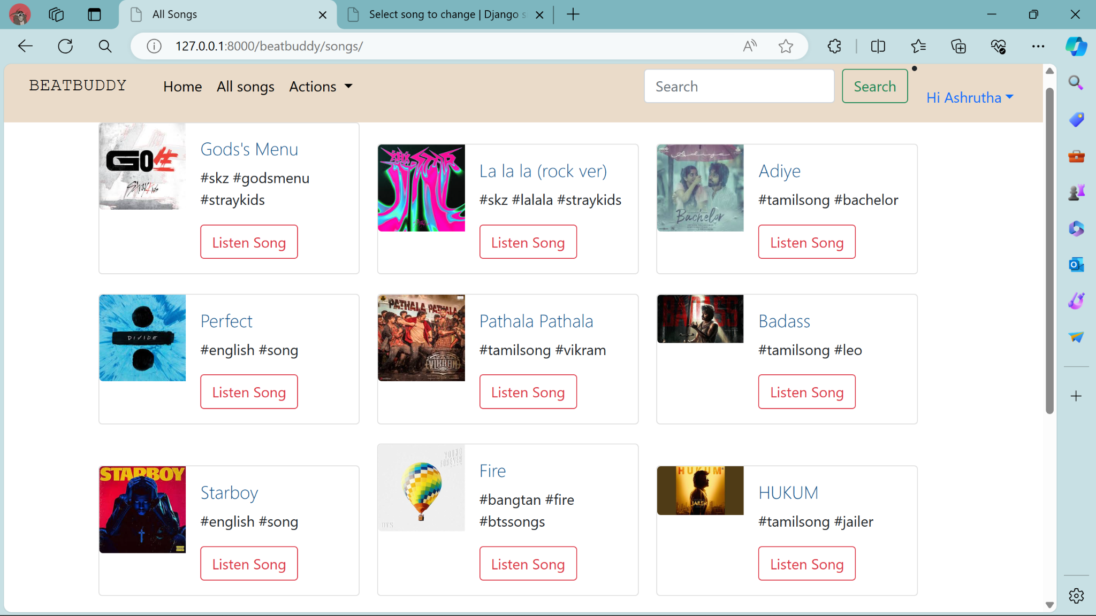
Service-Page

Slide 15
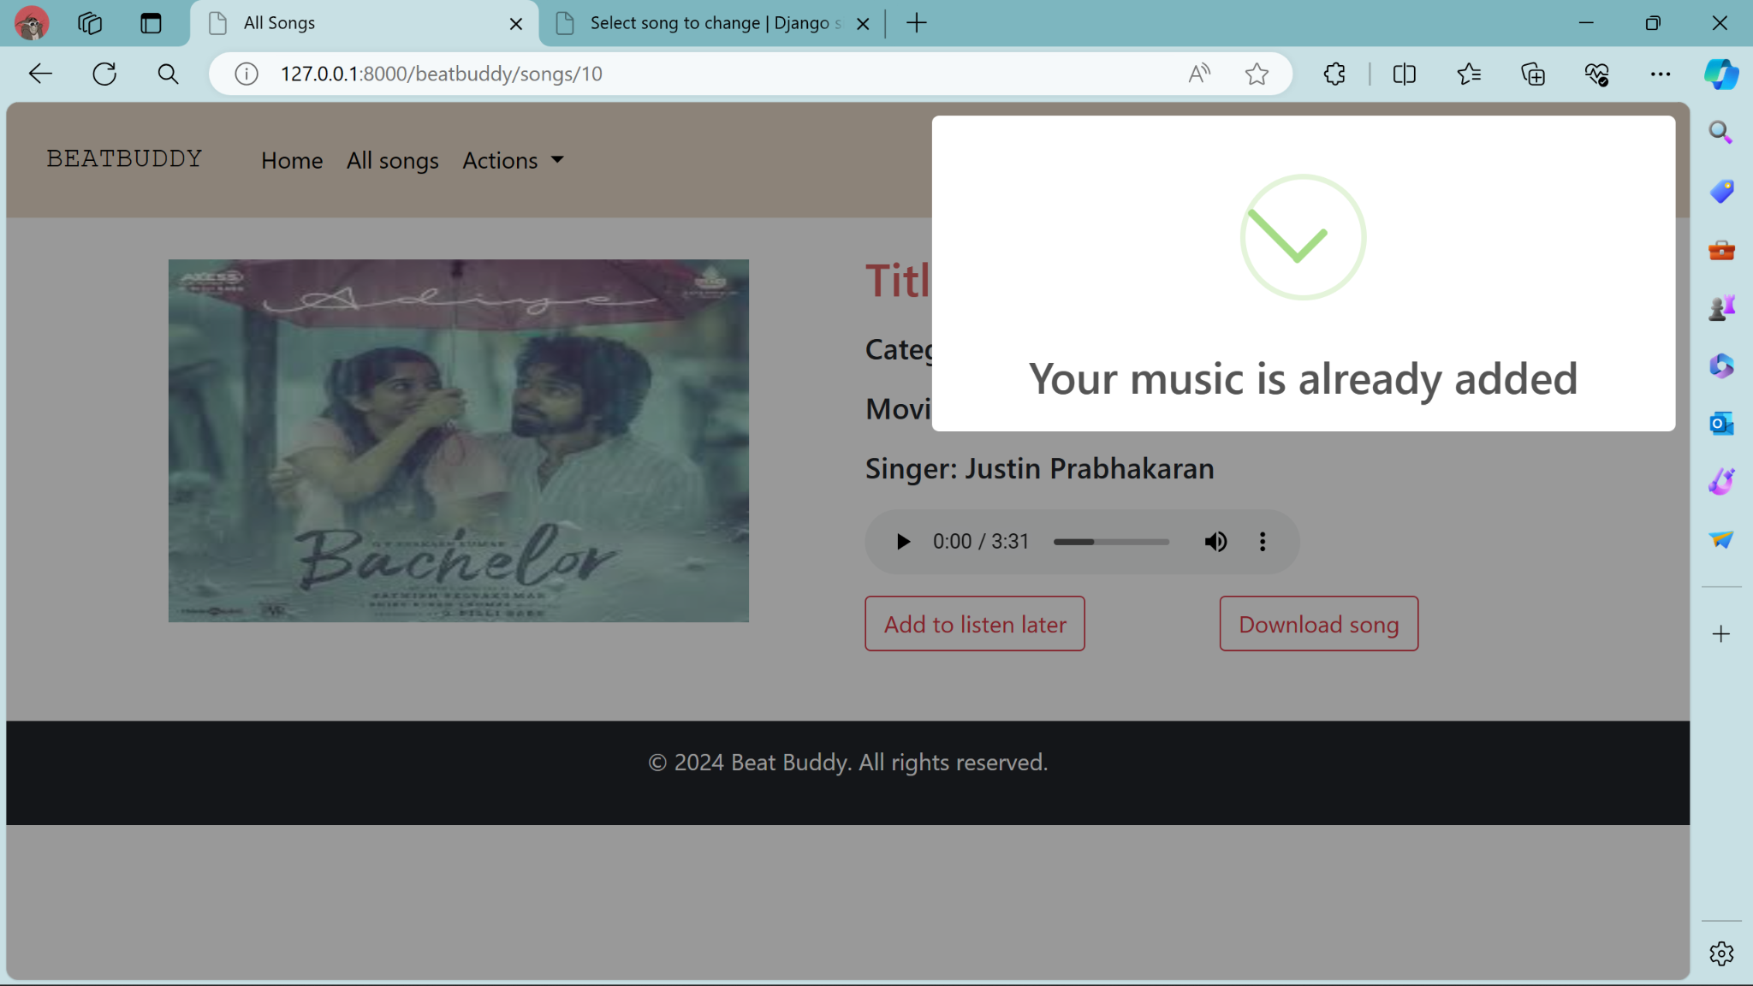
Listen later-Page

Slide 16
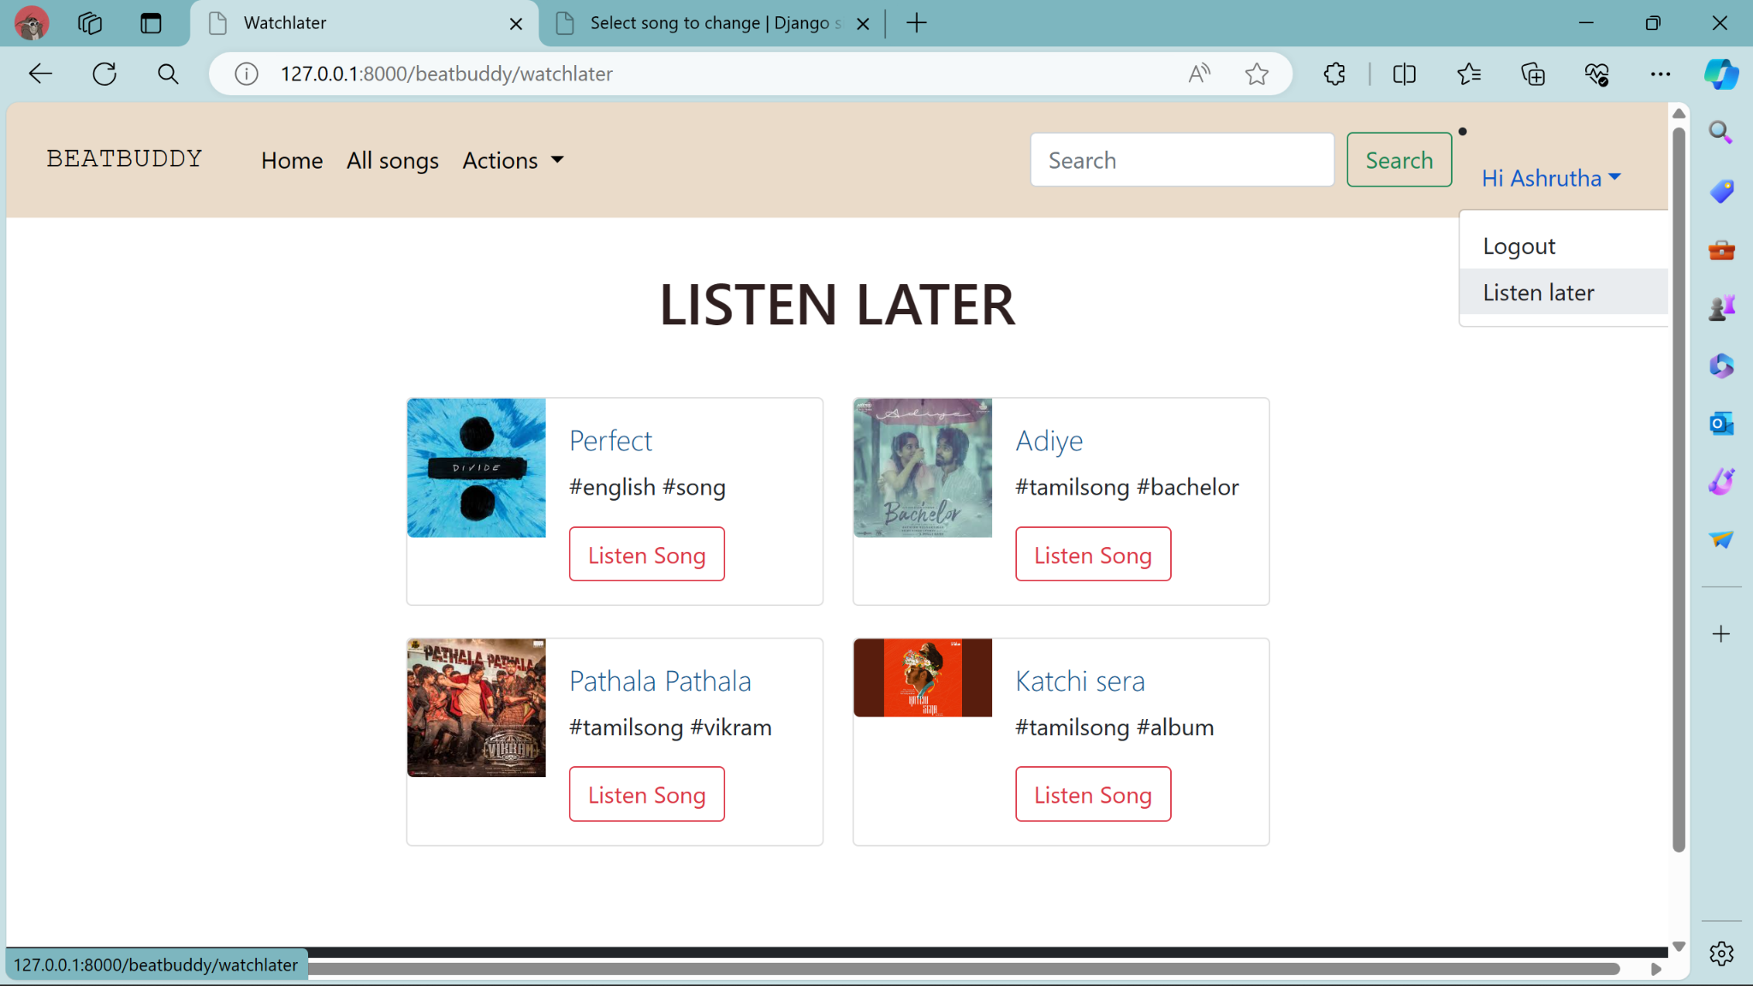
Listen later-Page

Slide 17
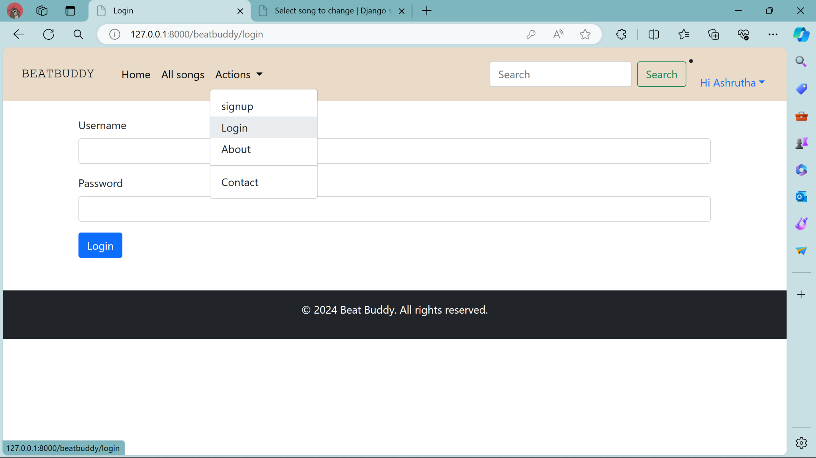
Login-Page

Slide 18
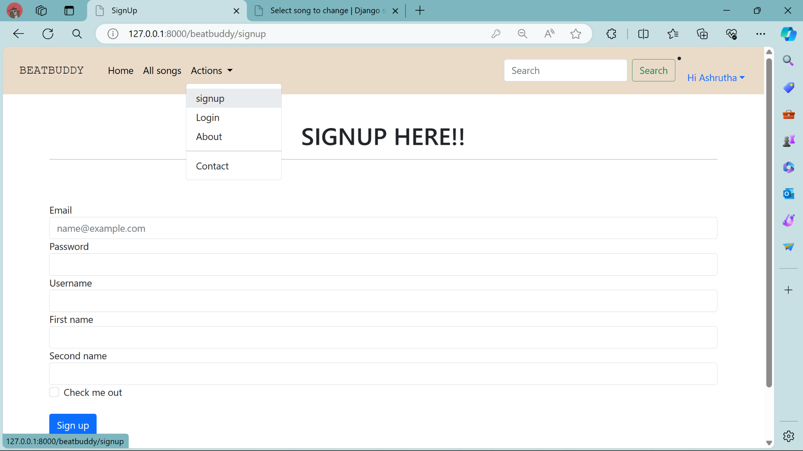
Signup-Page

Slide 19
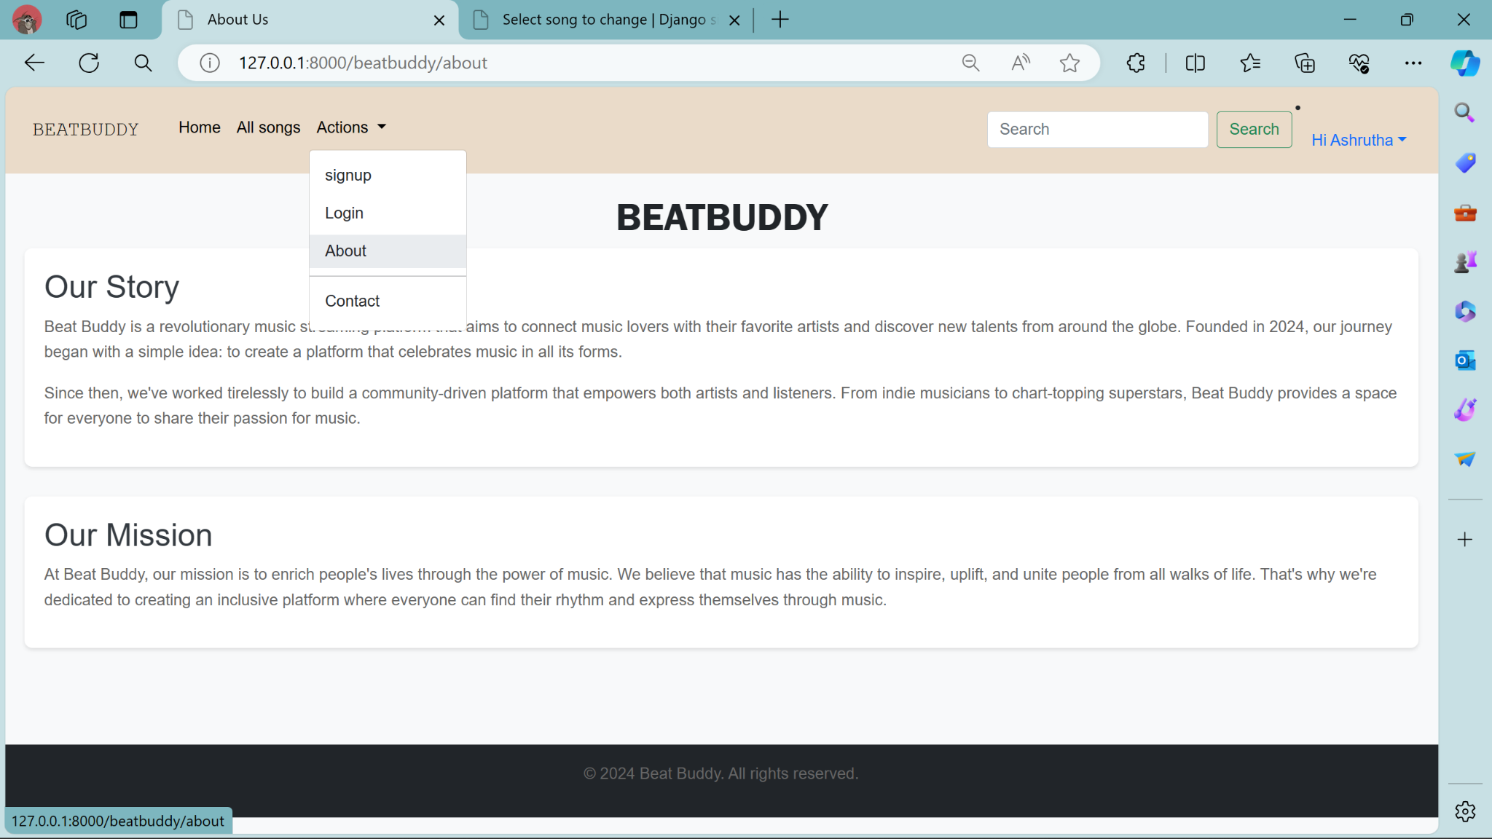
About-Us-Page

Slide 20
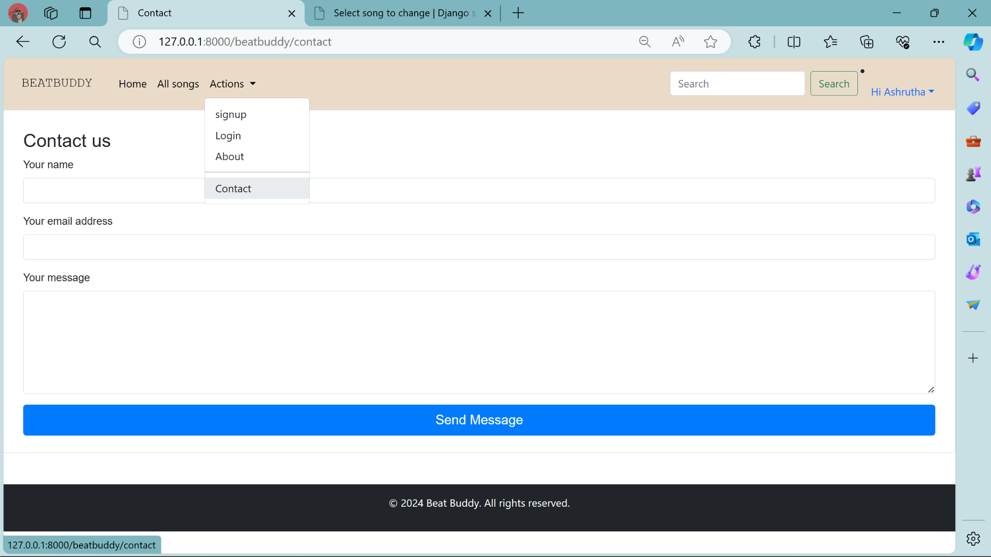
Contact-Us-Page

Slide 21
Future Enhancements:
Personalized Recommendations: Utilize advanced algorithms to analyze user listening habits, preferences, and contextual data to offer tailored music recommendations.
Social Integration: Implement features that enable users to connect with friends, share playlists, view what others are listening to, and collaborate on music discovery.
AI-Driven Playlist Creation: Employ artificial intelligence algorithms to curate playlists based on user preferences, mood, activity, and even contextual factors like weather or location.
Enhanced Discovery Tools: Develop tools such as interactive maps showcasing local music scenes, virtual concerts, or immersive experiences for users to explore new genres and artists.
Lyric Integration: Integrate lyrics into the app, allowing users to follow along with songs, search based on specific lyrics, and even provide translations for multilingual lyrics.
Live Streaming and Virtual Concerts: Partner with artists and venues to offer live streaming of concerts, virtual reality experiences, and exclusive behind-the-scenes content for users.
Music Education Resources: Provide tutorials, instrument lessons, music theory quizzes, and interactive challenges to help users learn more about music and improve their skills.
Voice Control and Integration: Enable voice-controlled commands for hands-free operation, allowing users to search for songs, control playback, and navigate the app using voice commands.

Slide 22
Conclusion:
Developing a music application using Django offers a robust foundation for a user-friendly and scalable platform. Through secure user authentication, comprehensive song catalog management, and intuitive frontend design, we've created a functional prototype. Looking forward, planned enhancements such as advanced search, social features, and mobile app integration promise to elevate the application's utility and appeal. Continuous integration, accessibility improvements, and machine learning-driven recommendations will further enhance the user experience. This project highlights the versatility of Django in building complex web applications and underscores the importance of iterative development based on user feedback. With these enhancements, the music application is poised to evolve into a comprehensive and engaging platform for music enthusiasts worldwide.
Source :

Slide 23
Thank You!
Notes:
Thank You !!

